Slide 1
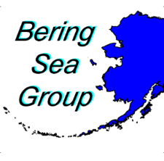
The Role of Seafloor Water Temperatures on the Distribution of Fishes and Invertebrates in the Eastern Bering Sea
Alaska Fisheries Science Center
Dr. Lyle L. Britt
NOAA-Alaska Fisheries Science Center
Resource Assessment & Conservation Engineering Division
Groundfish Assessment Program
Seattle, WA
October 30, 2018

Slide 2
Talk Outline
Survey area map, vessels, and gear
Seafloor Temperatures and extent of Cold Pool
2003 - 2018
Distribution Changes in Select Species of Fish and Invertebrates.
Summary

Slide 3
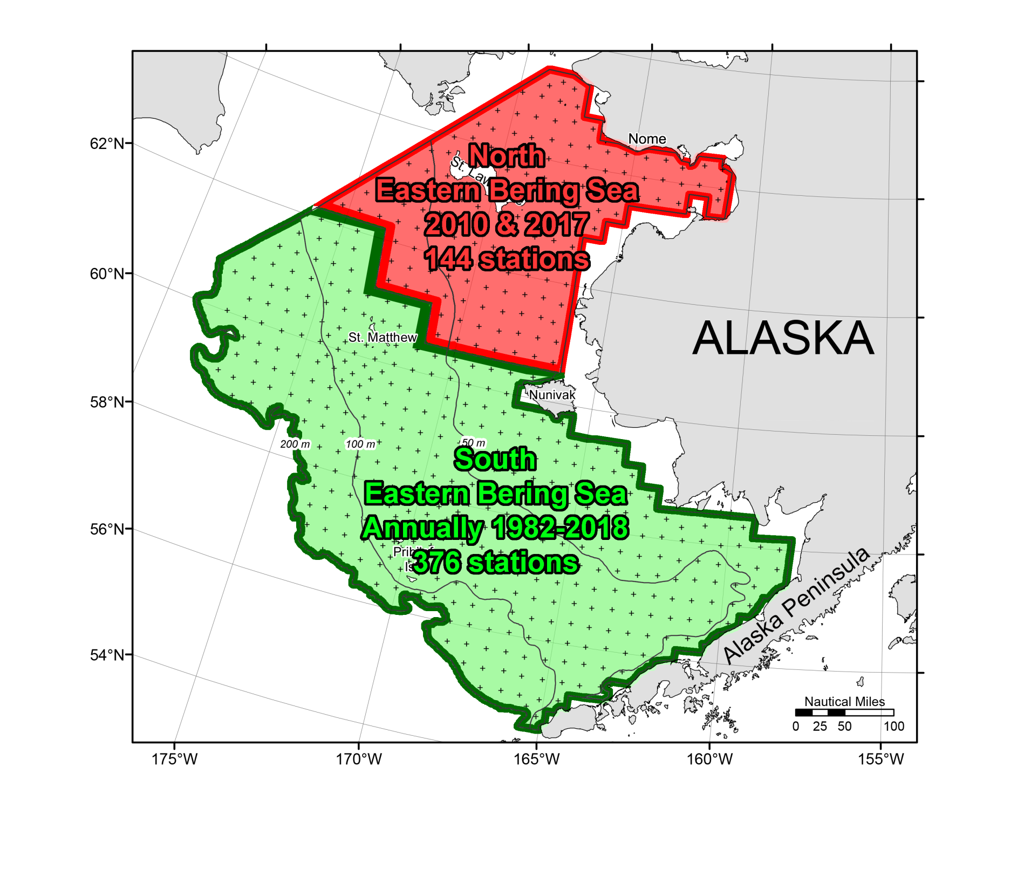
Standard Eastern Bering Sea Shelf Surveys
20 nm² grid pattern
Historical survey
boundary

Slide 4
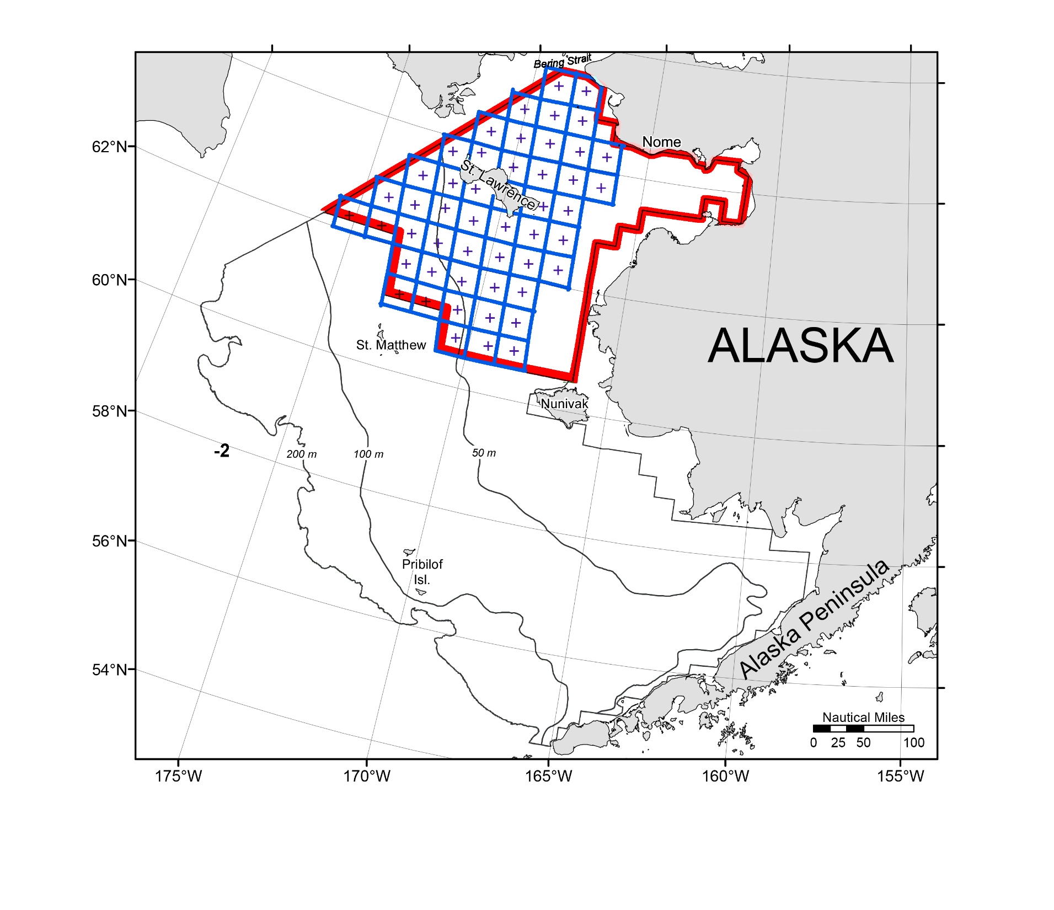
“Rapid response” 2018 NBS survey
“Special” 30 nm² grid pattern
49 stations 2018

Slide 5
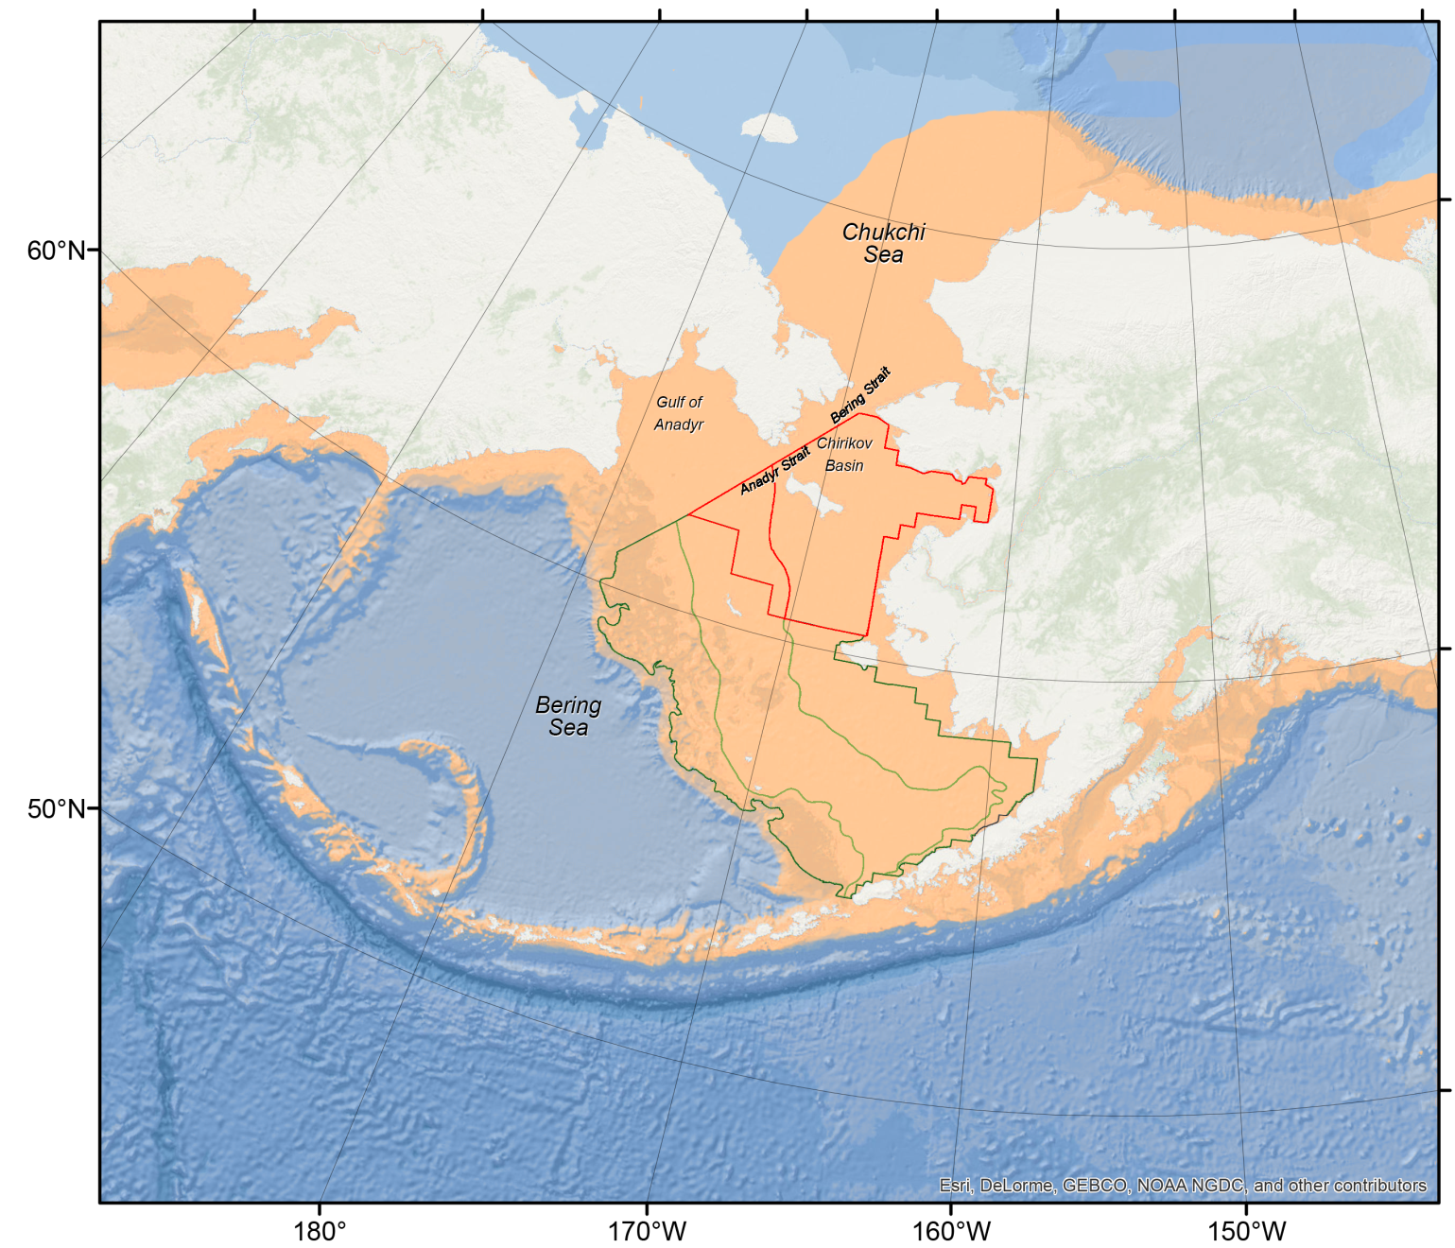
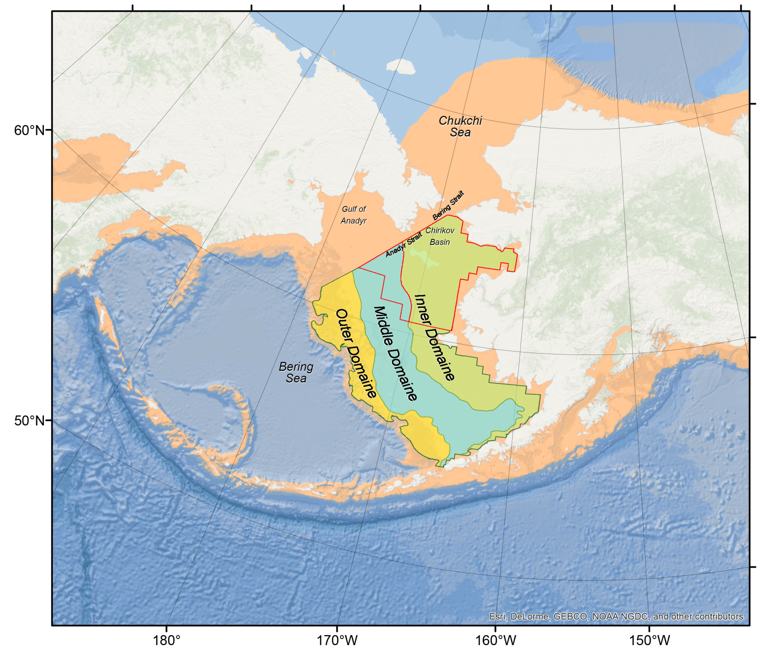
Eastern Bering Sea Shelf Environment
Bottom depth < 200m
50m
100m
200m

Slide 6
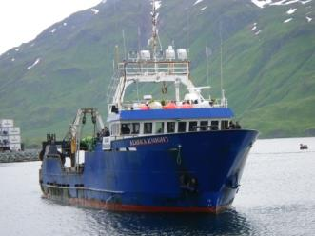
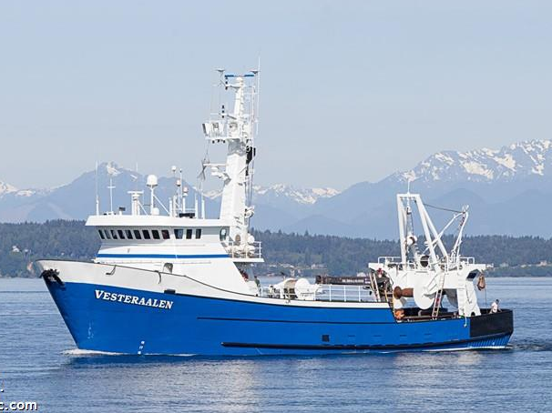
2018 Survey Charter Vessels
SEBS & NBS
May 31 – August 20
SEBS & NBS
May 31 – August 7
FV Alaska Knight
2010 -present
9^{h} year
FV Vesteraalen
2014 -present
5th year

Slide 7
Survey gear & methods 83-112 research trawl Same gear and methods since 1982!
~50 ft

Slide 8
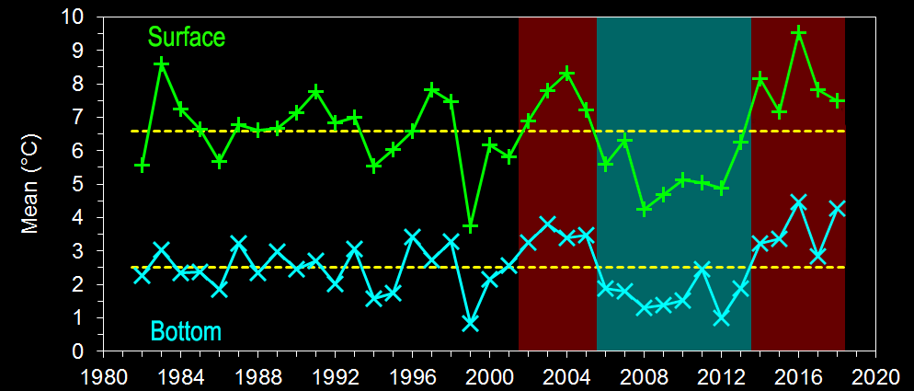
Mean Seafloor Bottom Temperature Standard SEBS survey area
Long-term mean
6.6°C
4.3°C
Long-term mean
2.5°C
0.8°C

Slide 9
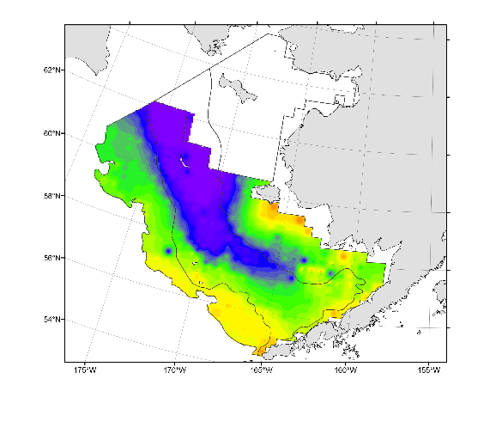
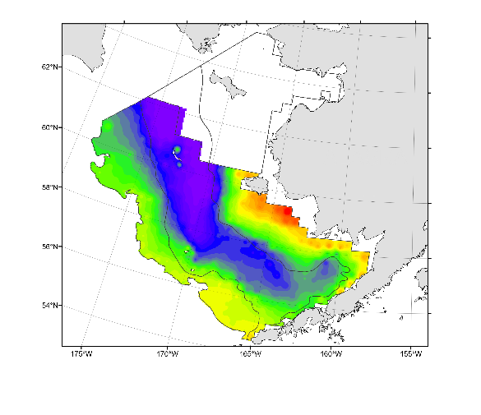
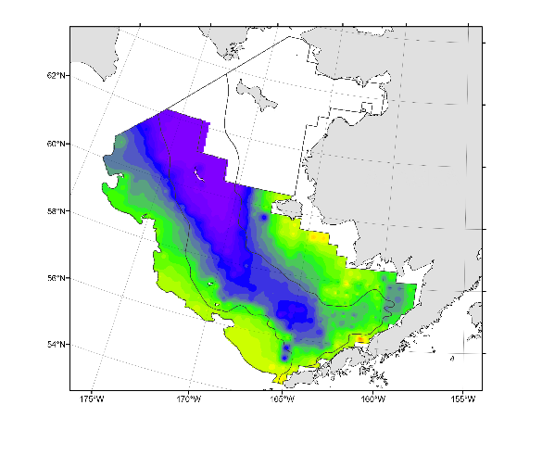
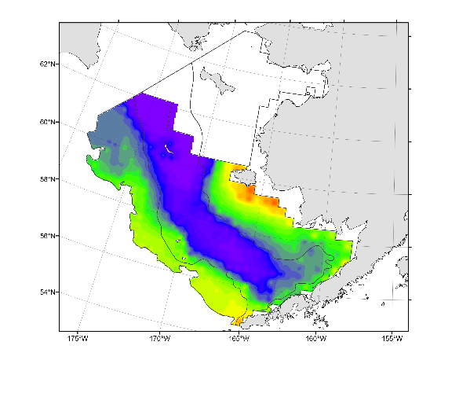
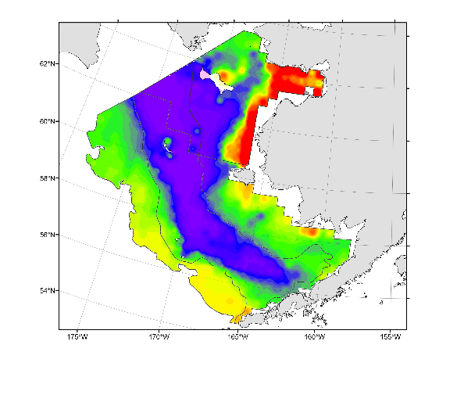
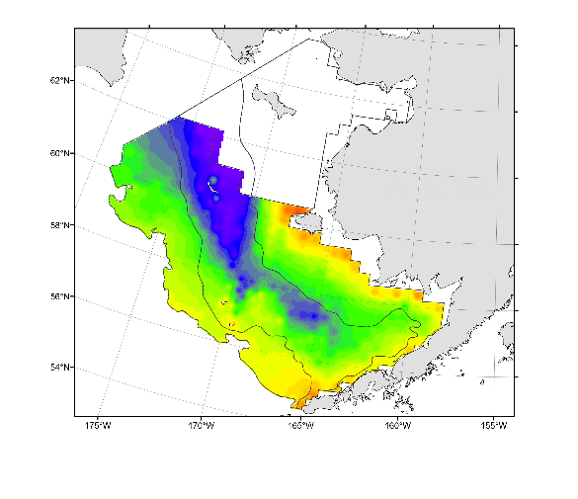
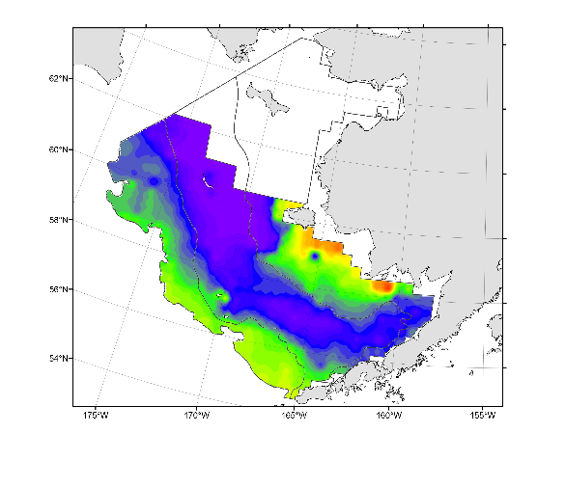
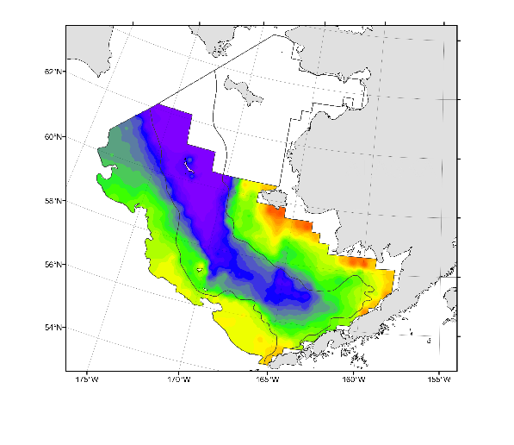
Eastern Bering Sea Shelf Environment
Ice extent/seafloor temps shape fish/crab distribution
Colder years
2006
2007
2008
2009
2010
2011
2012
2013
-2
0
2
4
6
°C

Slide 10
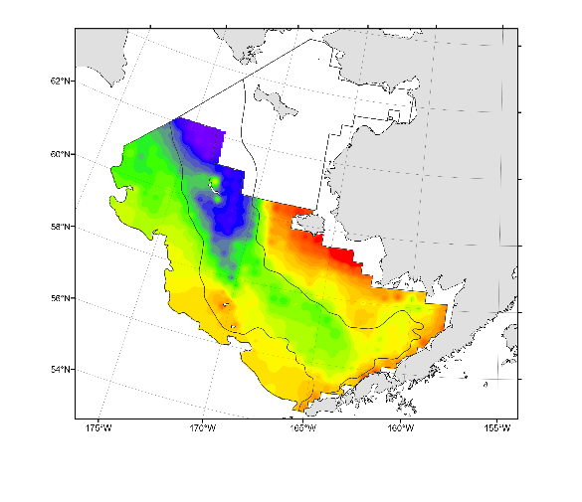
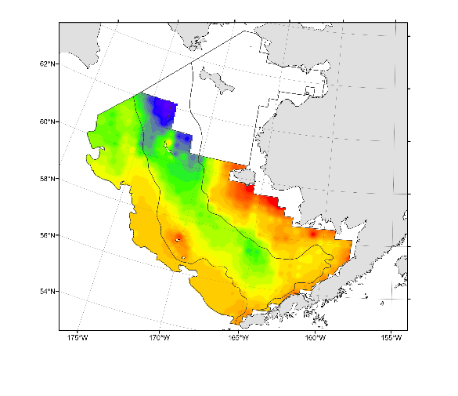
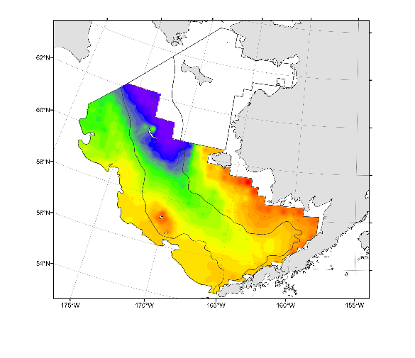
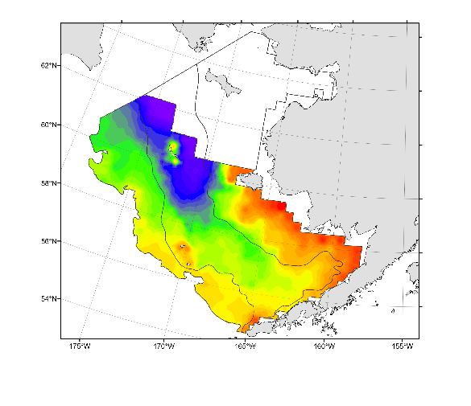
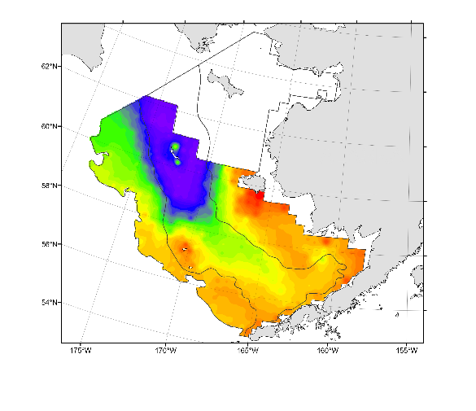
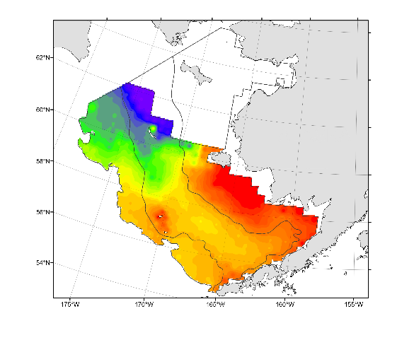
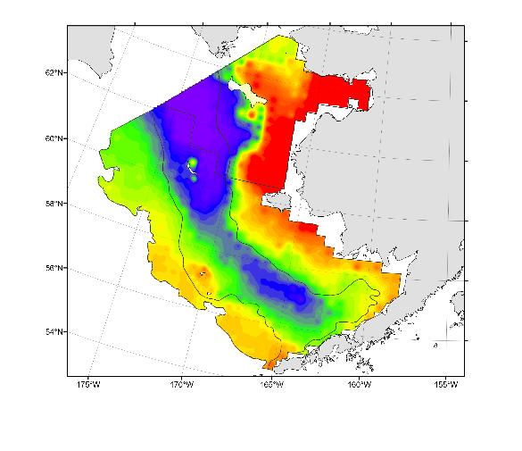
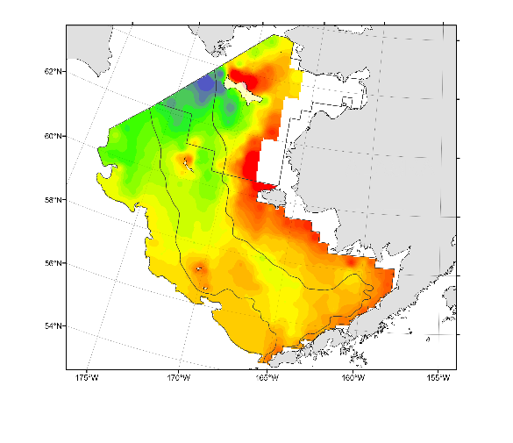
Eastern Bering Sea Shelf Environment
Ice extent/seafloor temps shape fish/crab distribution
Warmer years
2003
2004
2005
2014
2015
2016
2017
2018
-2
0
2
4
6
°C

Slide 11
Northern Bering Sea Seafloor Temperatures
2010
2017
2018
-2
0
2
4
6
°C

Slide 12
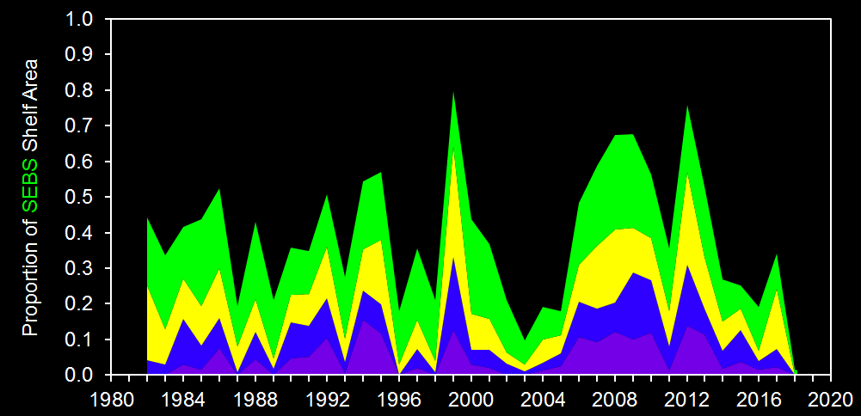
Cold Pool Area Coverage Standard SEBS survey area
< 2° to 1°
< 1° to 0°
< 0° to -1°
< 0° to -1°
< -1°
< -1°
1% of
shelf area

Slide 13
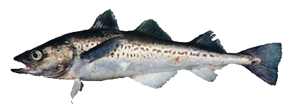
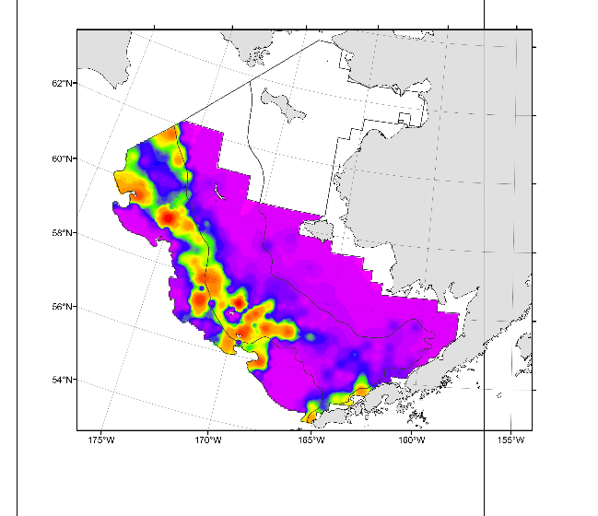
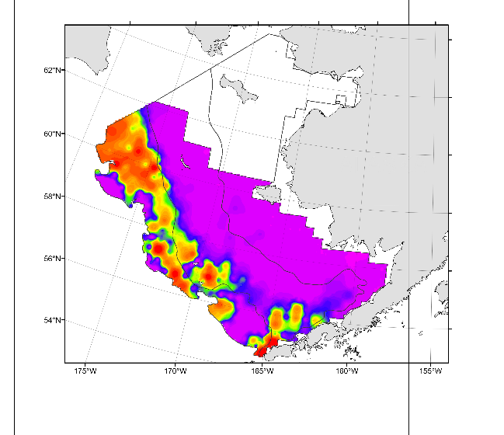
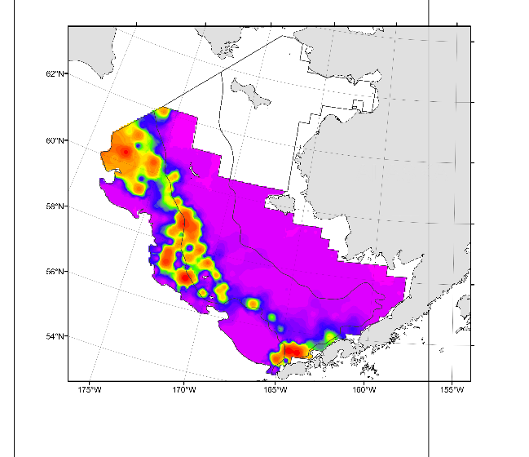
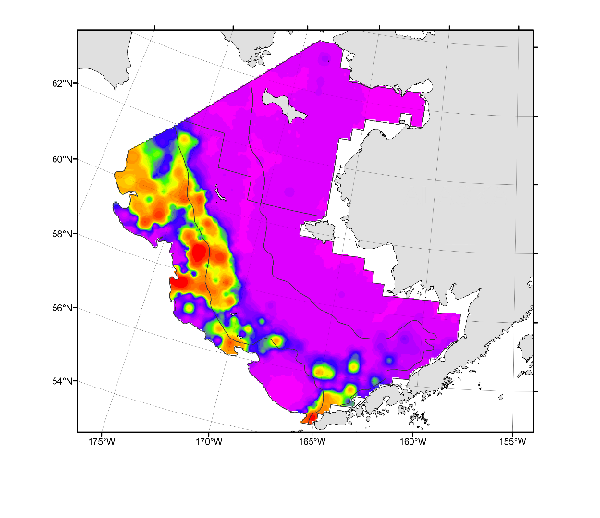
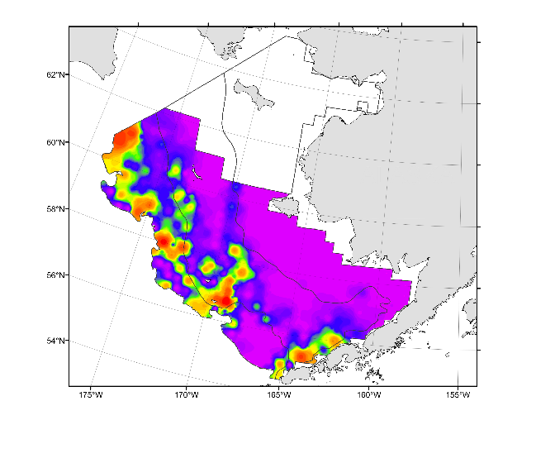
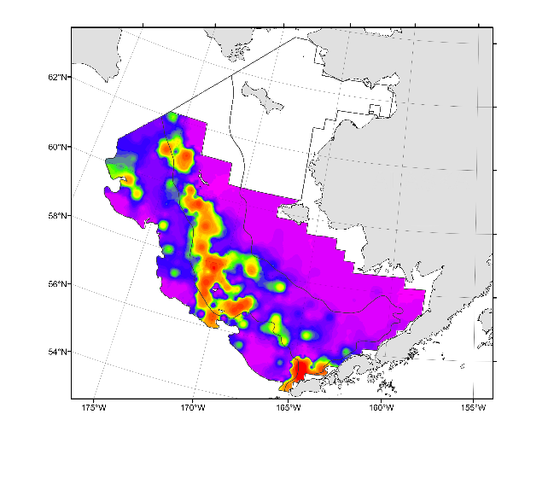
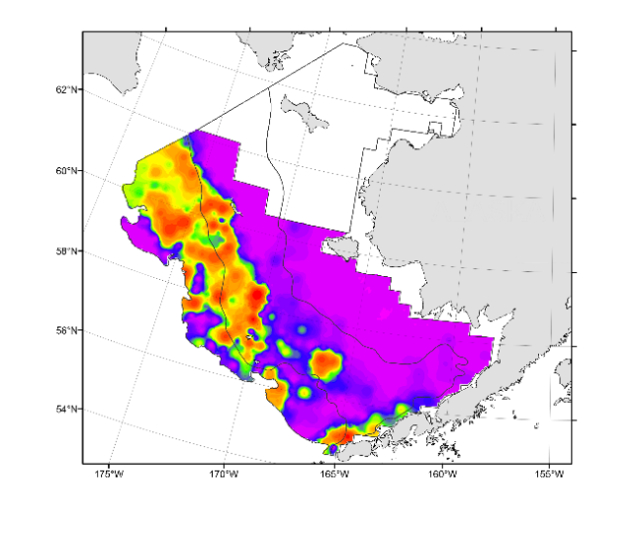
Walleye pollock distribution
Colder years
2006
2007
2008
2009
2010
2011
2012
2013
0
40
100
175
>300
kg/ha

Slide 14
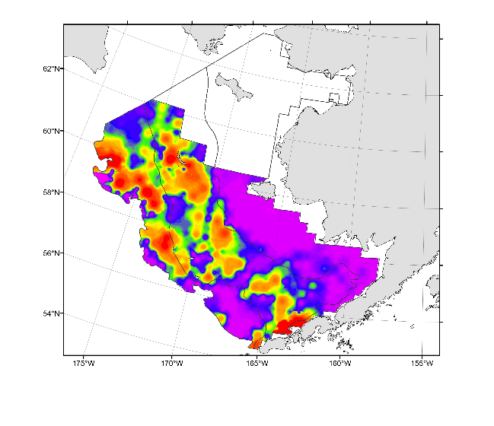
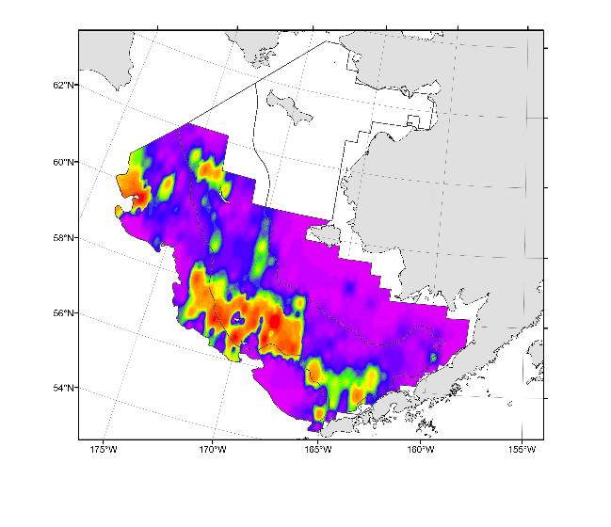
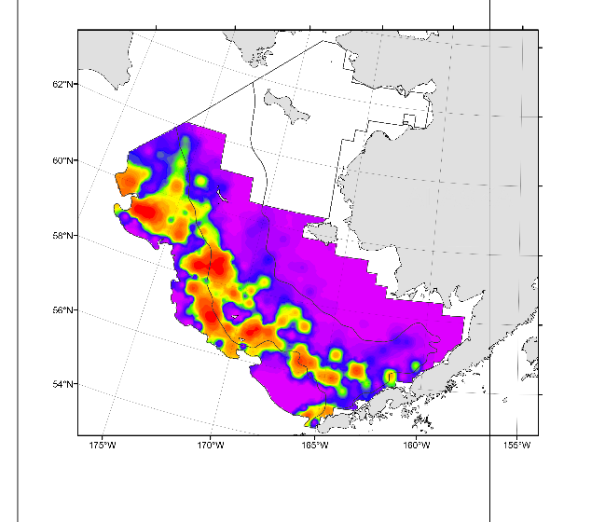
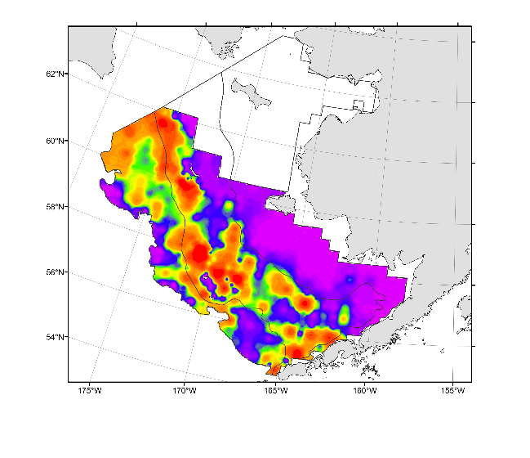
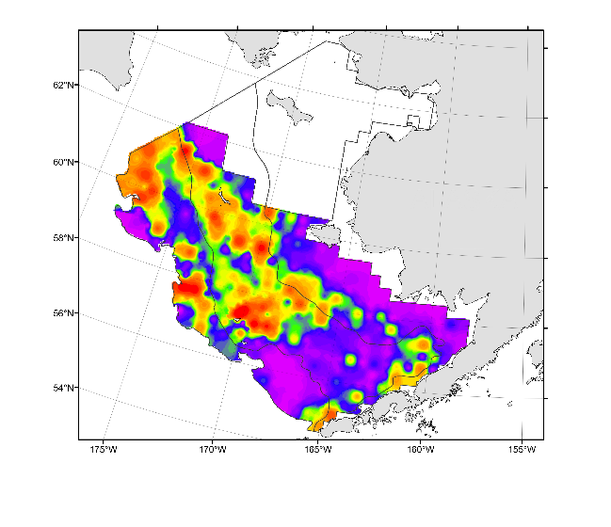
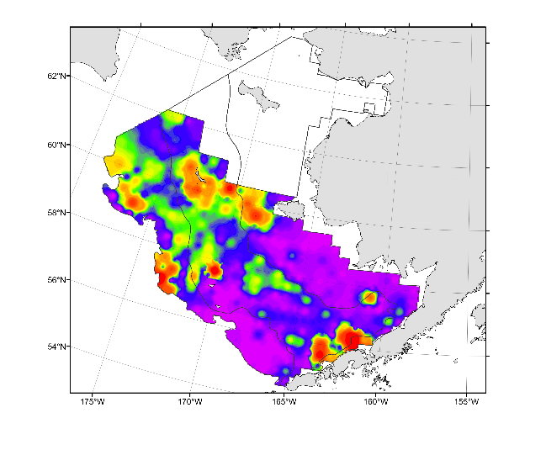
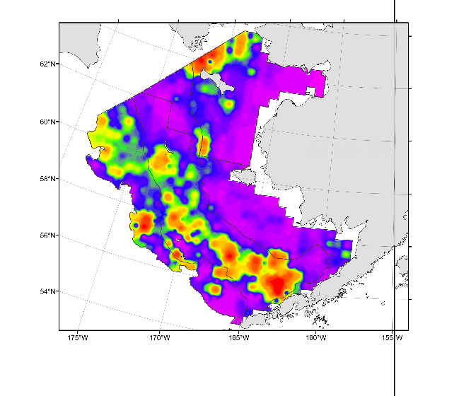
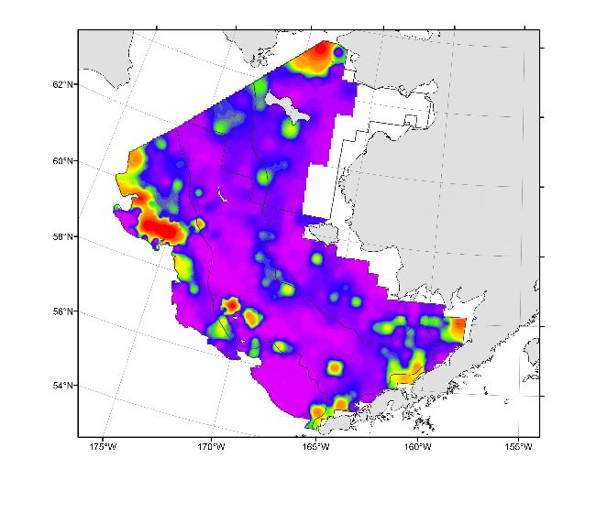
Walleye pollock distribution
Warmer years
2003
2004
2005
2014
2015
2016
2017
2018
0
40
100
175
>300
kg/ha

Slide 15
Walleye pollock distribution
2015
2016
2010
2017
2018
0
40
100
175
>300
kg/ha

Slide 16
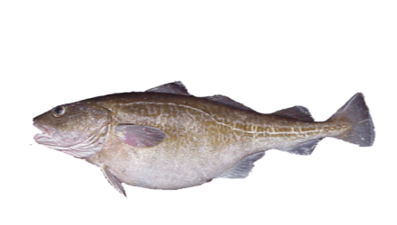
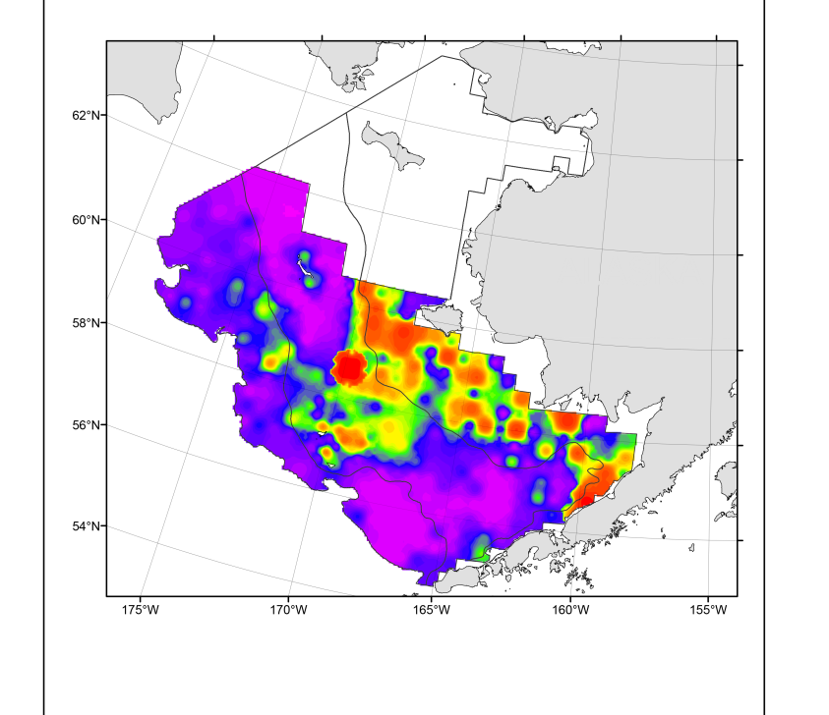
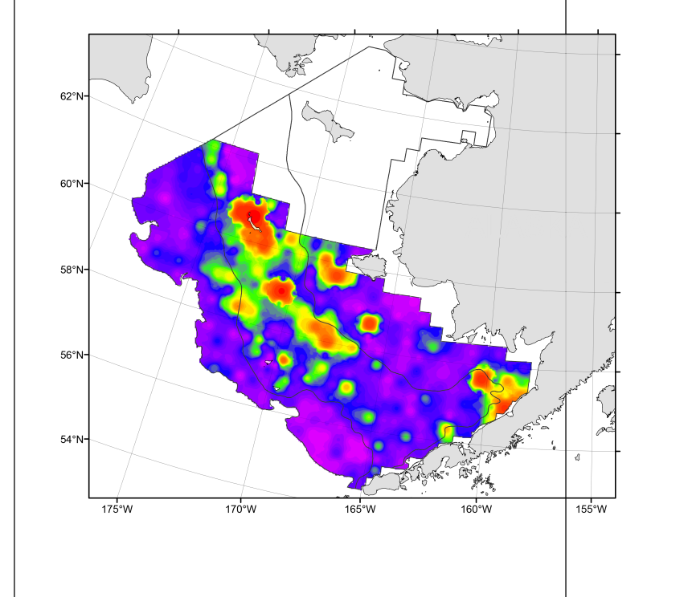
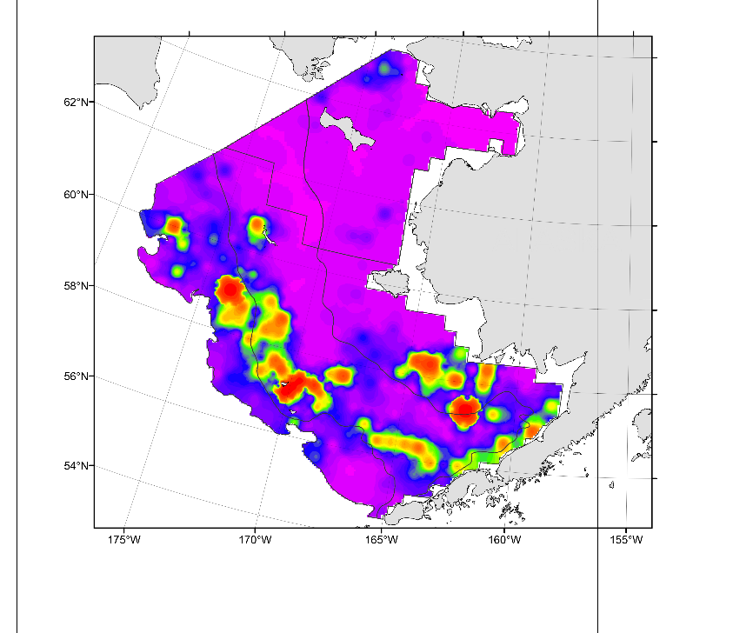
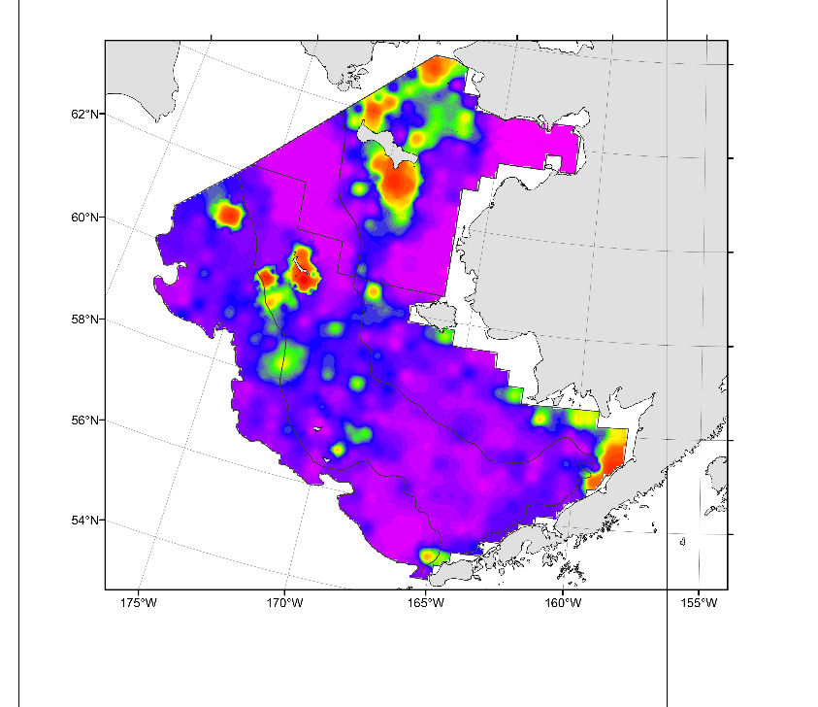
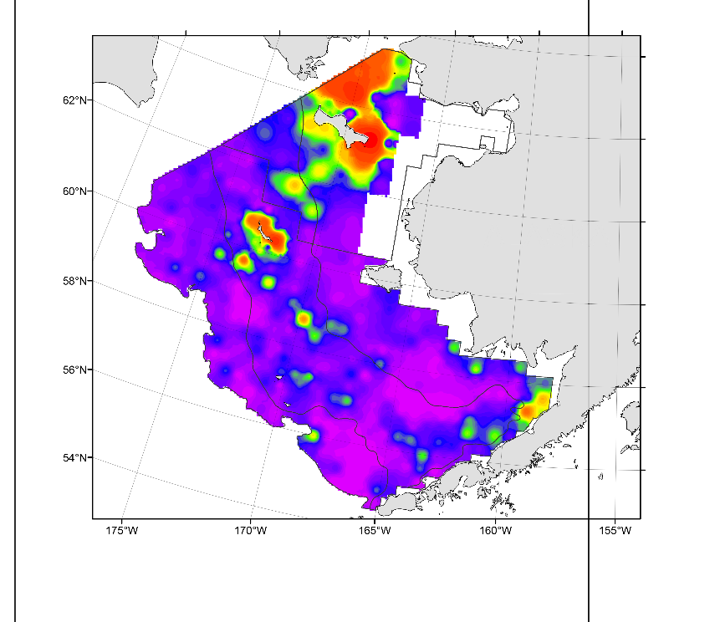
Pacific cod distribution
2015
2016
2010
2017
2018
0
15
25
40
>50
kg/ha

Slide 17
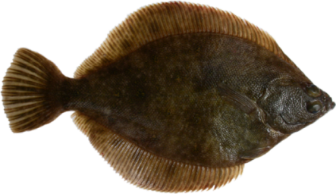
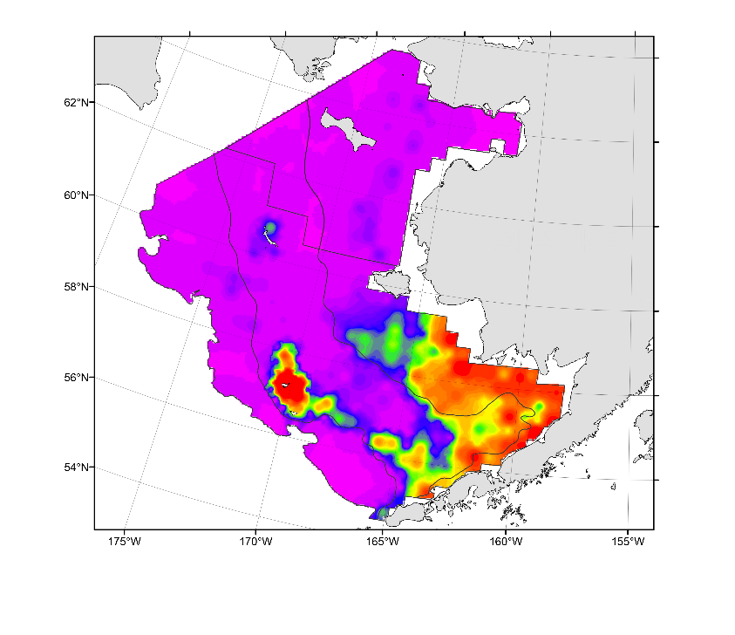
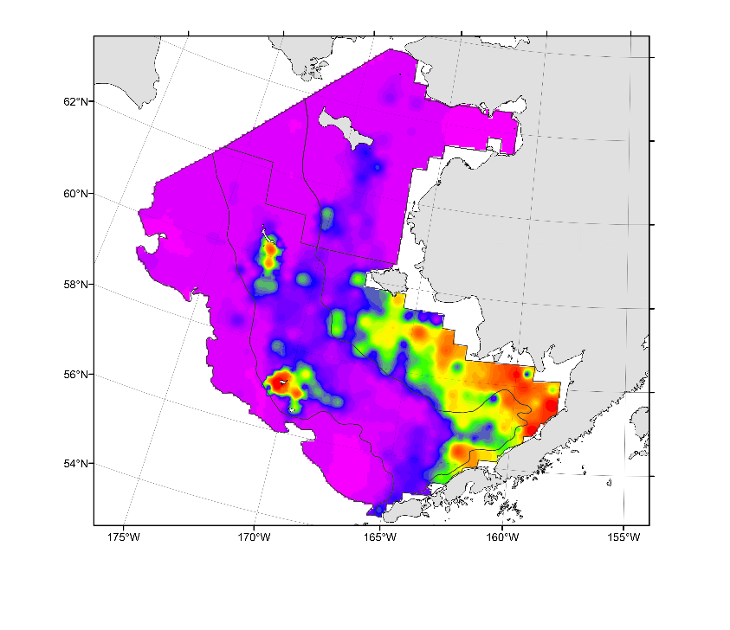
Northern rock sole distribution
recruitment
2010
2017
2018
0
15
40
75
>150
kg/ha

Slide 18
Pacific halibut distribution
2010
2017
2018
Poor survey
coverage
kg/ha

Slide 19
Jellyfish distribution
2010
2017
2018
0
15
40
75
>150
kg/ha

Slide 20
Distributions of Arctic species
Snow crab
2010
2018
0
5
15
25
>40
kg/ha
Arctic cod
7 fish
2010
2018
0
2
5
10
>20
0 fish
kg/ha

Slide 21
General summary
NBS surveys 2010 & 2017-18 offer cold/warm snapshots
Sub-Arctic species expanding, dispersing and recruiting (spawning?)
Arctic species retracting
Next planned standard NBS survey in 2019
Long-term biennial monitoring of NBS necessary
Unknowns
Anomaly or in transition to “new normal”?
Will 2019 be warm or cold year?
Extent of winter sea ice, migration, mortality, survival in NBS or under ice?
Population stock structure
Continued NBS survey funding beyond 2019
Impact of large influx of pelagic consumers into the NBS ecosystem?
Spatial availability to surveys?
?!

Slide 22
Questions?

